Slide 1
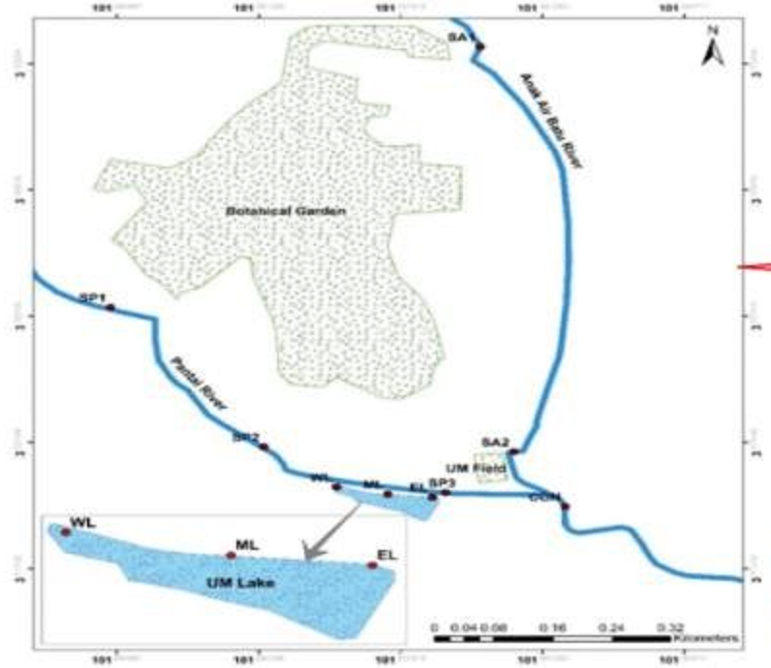

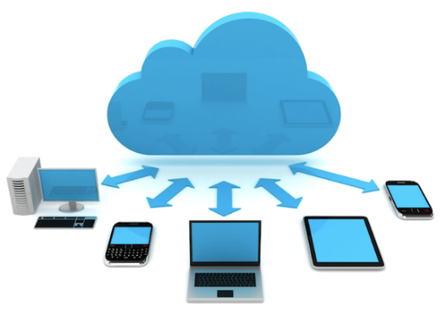

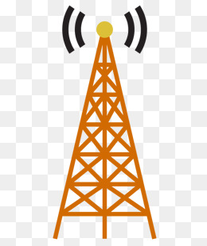
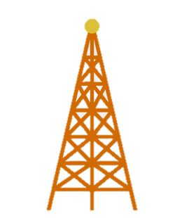
Appendix A
Sub-Programme 2: Intelligent Long Range (LoRa) Mesh Network Monitoring System for River Conservation Management
Problem Statement
A Clean, Safe, Healthy & Productive River Monitoring for Sustainable Development
Node
Station
Internet
Method
LoRa Mesh Networking
Cloud Computing
Internet of Things
System Integration
Node
Station
Final Station
Gateway
Node
Station
Expected Outcome
Working System of LoRa Mesh Network Station for UM River conservation Management
Node
Station

